Slide 1
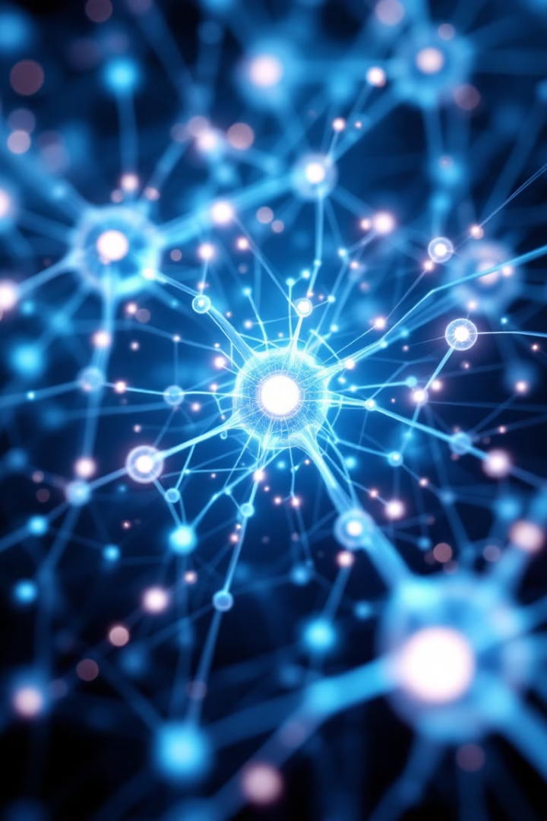
Convolutional Neural Networks (CNN) in Machine Vision
Transforming visual recognition through deep learning.
Instructor: Stephin Rachel Thomas
Feb 05, 2026

Slide 2

Today’s Topics
Artificial Neural Networks
Disadvantages of simple ANN for Image classification
Introduction to CNN
CNN architecture
Deep dive into CNN layers
Application of CNN
Performance Evaluation Metrics

Slide 3
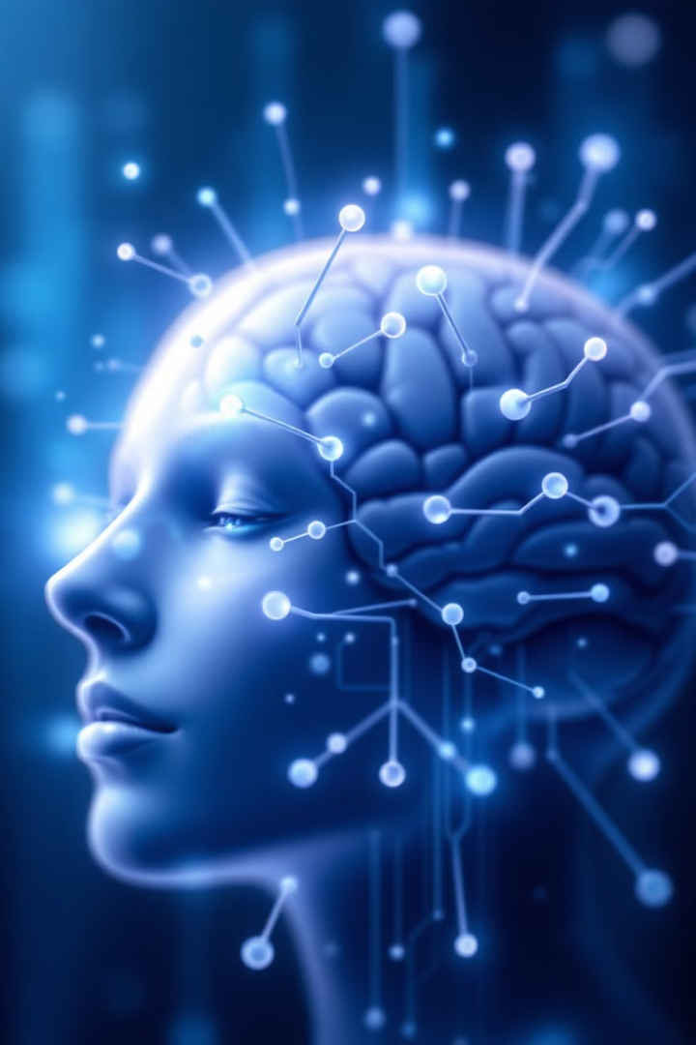
What are Artificial Neural Networks?
1
Biological Inspiration
2
Learning Through Data
ANNs are inspired by the structure and function of the human brain, composed of interconnected nodes called neurons.
These networks learn by analyzing large datasets, adjusting the connections between neurons to improve their performance.
3
Pattern Recognition
ANNs are particularly effective at recognizing complex patterns in data, making them ideal for image classification.

Slide 4
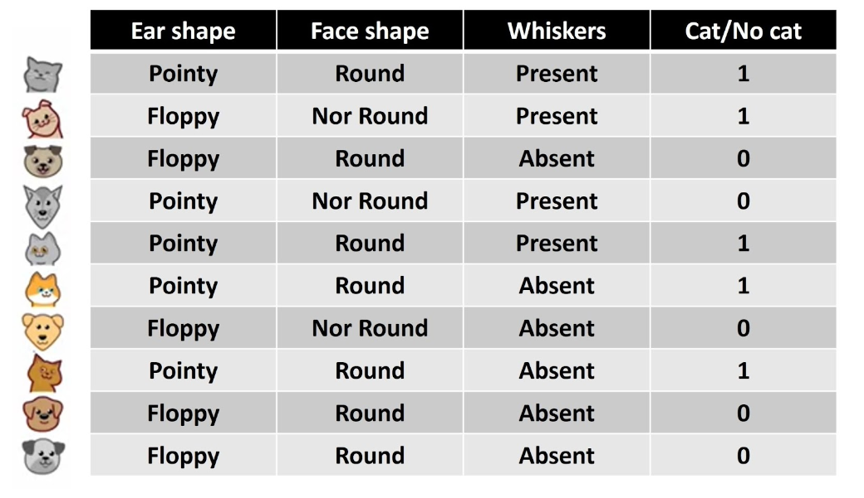
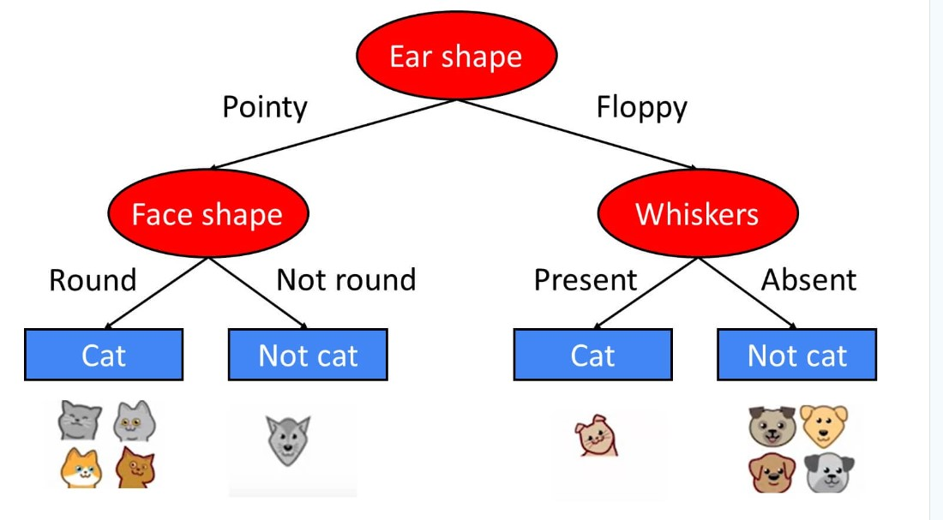
Classification using Traditional Methods
Decision-tree method

Slide 5
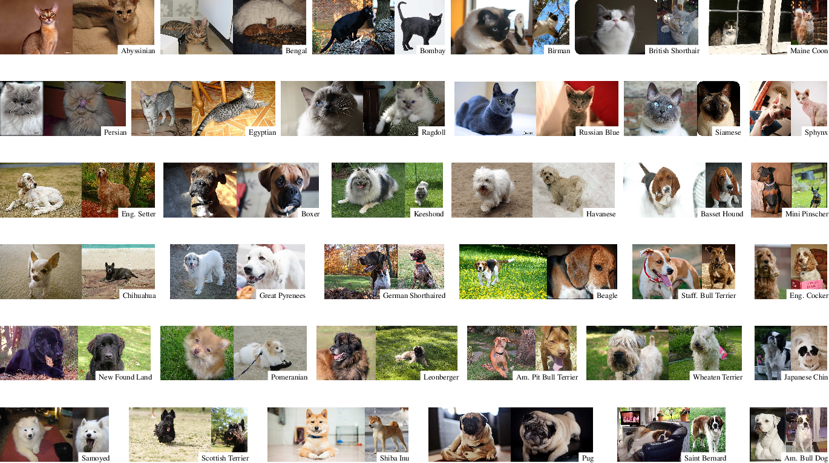
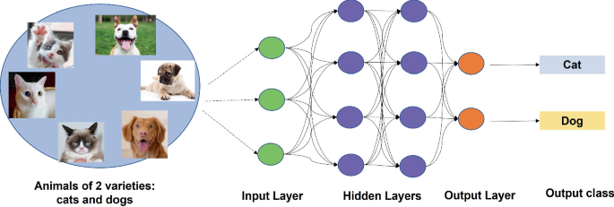
ANN for Image Classification

Slide 6
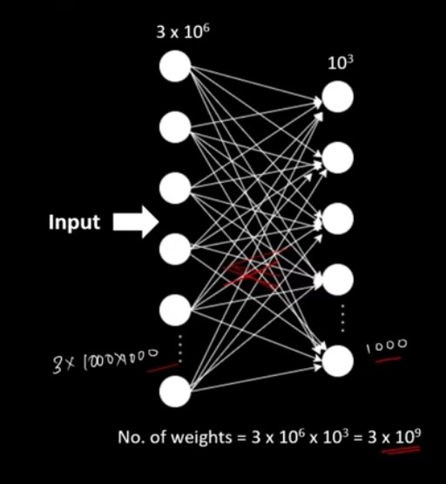
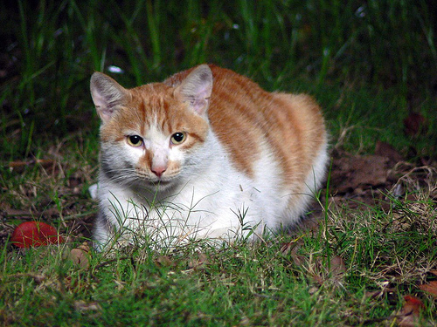
Limitation of ANN for Image Classification
1000 * 1000px
High compuational cost
Over-fitting problem
Longer training time

Slide 7
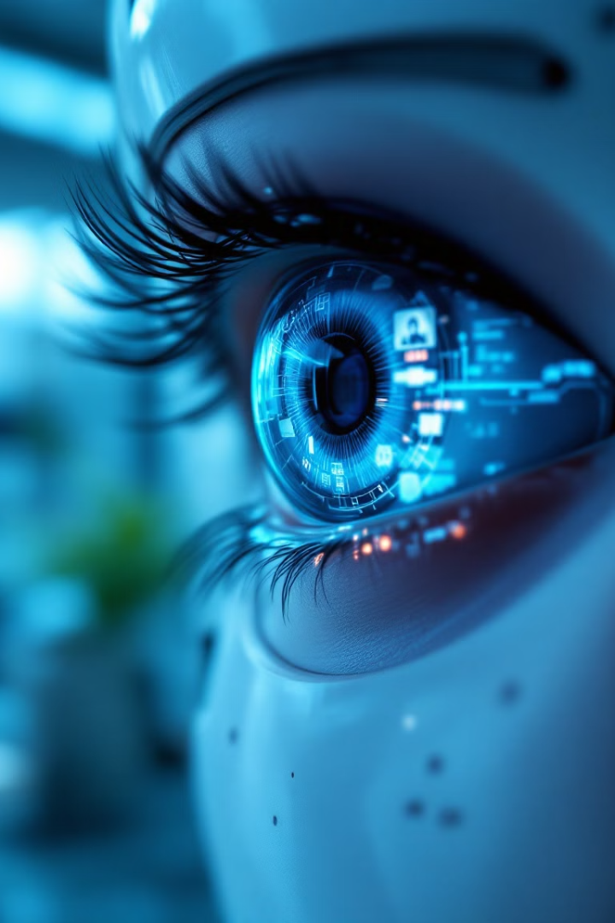
Convolutional Neural Network (CNN)
1
Definition
2
Objective
A deep learning model designed for processing images to identify patterns and make decisions.
Solve complex visual tasks with deep learning.
3
Benefits
Handles high-dimensional, structured data like images, videos and audio.
Hierarchical feature learning.
Robust to translation of object.

Slide 8
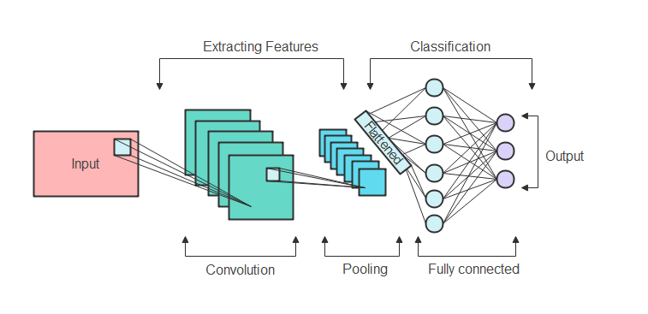
CNN Architecture
CNNs typically consist of an input layer, multiple hidden layers, and an output layer.
The hidden layers include a series of convolutional layers, pooling layers and fully connected layers.
Each layer performs distinct operations: Convolutional layers apply a convolution operation, Pooling layers perform down-sampling, Fully connected layers compute the class scores.

Slide 9
Key Components of CNN
Convolutional Layers
1
Extract spatial features from input images.
2
Pooling Layers
Reduce spatial dimensions, simplify computation.
Fully Connected Layers
3
Integrate features for final classification.

Slide 10
Deep Dive into Convolutional Layers
In these layers, small, learnable filters slide over the input data (like images) to extract features such as edges, textures, and shapes.
Each filter in a convolutional layer detects different features, and multiple layers work together to capture increasingly complex aspects of the data.
The convolutional layers thus play a crucial role in feature detection and representation, enabling CNNs to effectively perform tasks like image recognition and classification.

Slide 11
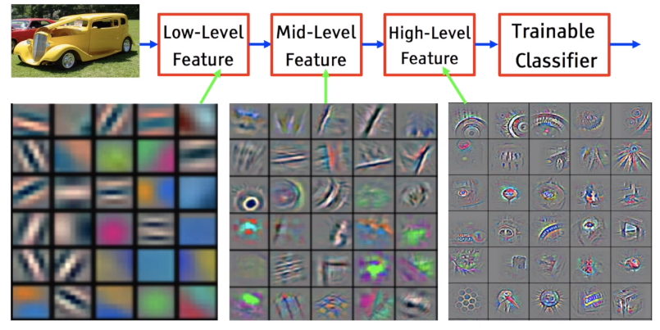
CNN Fundamentals
The basic principle of a Convolutional Neural Network (CNN) is to automatically learn and extract hierarchical features from input data, typically images, through the use of convolutional layers.

Slide 12
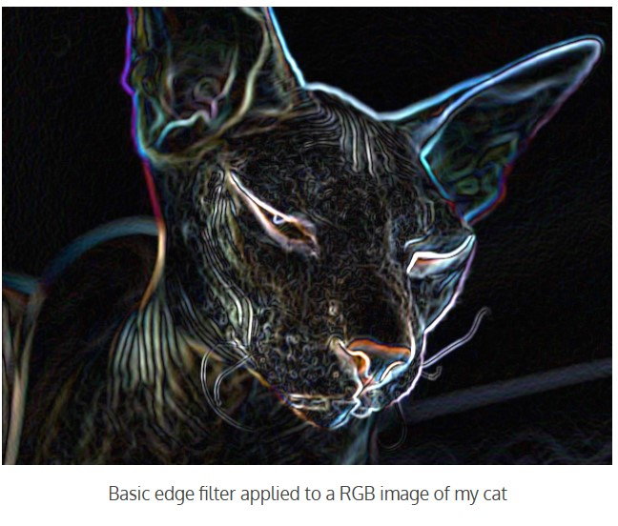
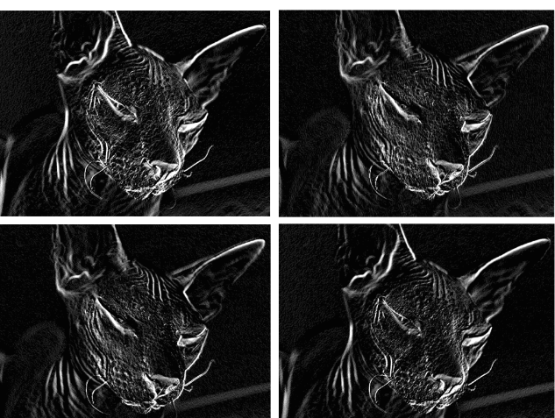
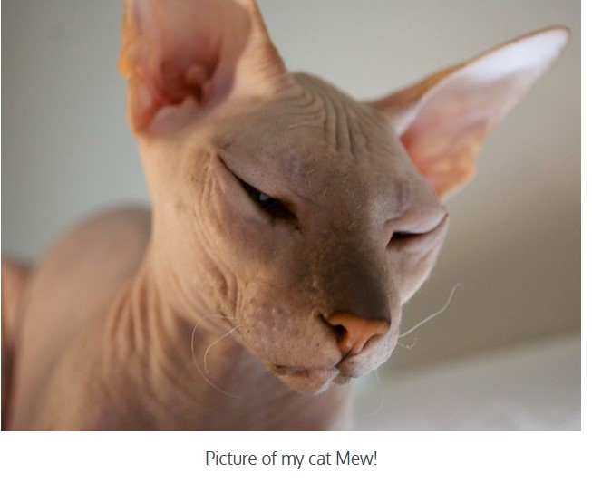
Convolutional Layers
Feature Maps
Convolutional layers help the network focus on only the most important features
Not all the pixel information in the image is relevant for training the model
Improves performance and accuracy

Slide 13
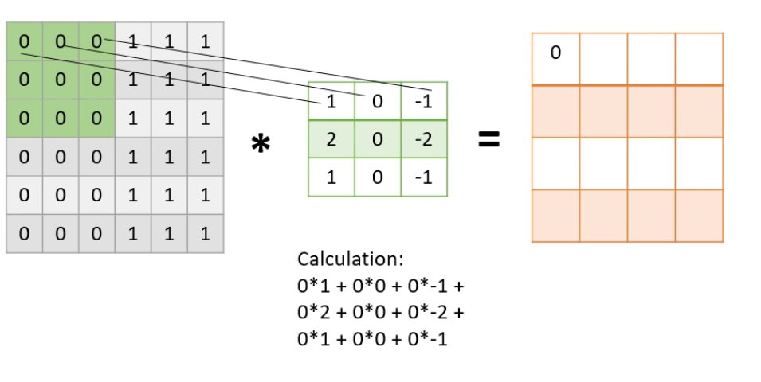
Convolution Operation
Filter
Input image
Output Image
Convolution operator

Slide 14
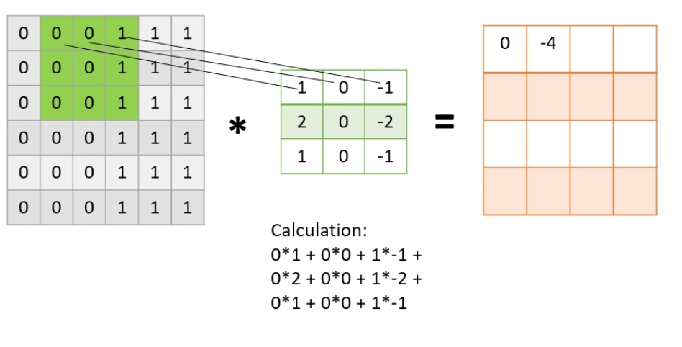
Convolution Operation

Slide 15
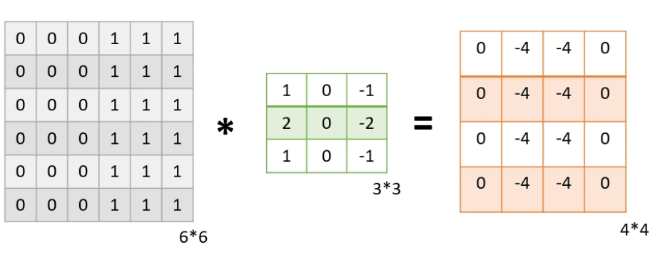
Convolution Operation

Slide 16
Convolutional Layers
The filter size determines the extent of the input data that each filter covers, affecting the granularity of the features detected; smaller filters capture fine details, while larger filters identify broader patterns.
Stride, the step size with which filters move across the input, influences the overlap of receptive fields and the size of the output feature map; larger strides result in smaller, more abstract feature maps.
Padding, the addition of zeroes around the input border, allows control over the spatial dimensions of the output, preserving edge information and enabling deeper layers to build a spatial hierarchy of increasingly complex and abstract features.

Slide 17
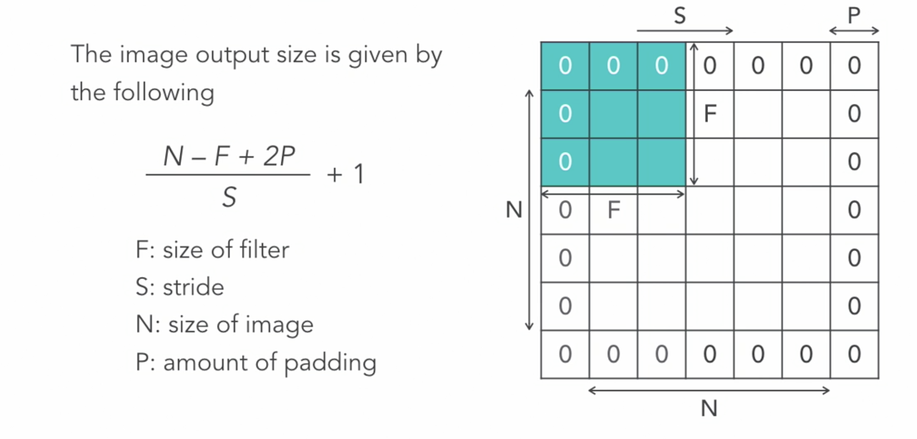
Convolutional Layer – Output Image Size

Slide 18
Pooling Layers
Responsible for reducing the spatial size of the feature maps generated by convolutional layers
By performing operations such as max or average pooling, they down sample the input features, which helps to decrease the computational load and the number of parameters in the network
This reduction also contributes to making the network more tolerant to variations and distortions in the input data, enhancing its ability to generalize.

Slide 19
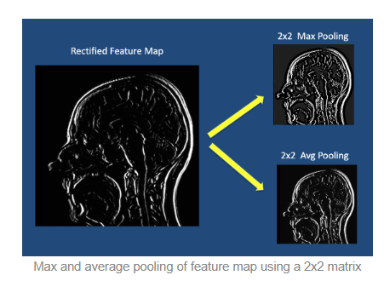
Pooling Layers
The pooling layer reduces the spatial dimensionality of the input feature map.

Slide 20
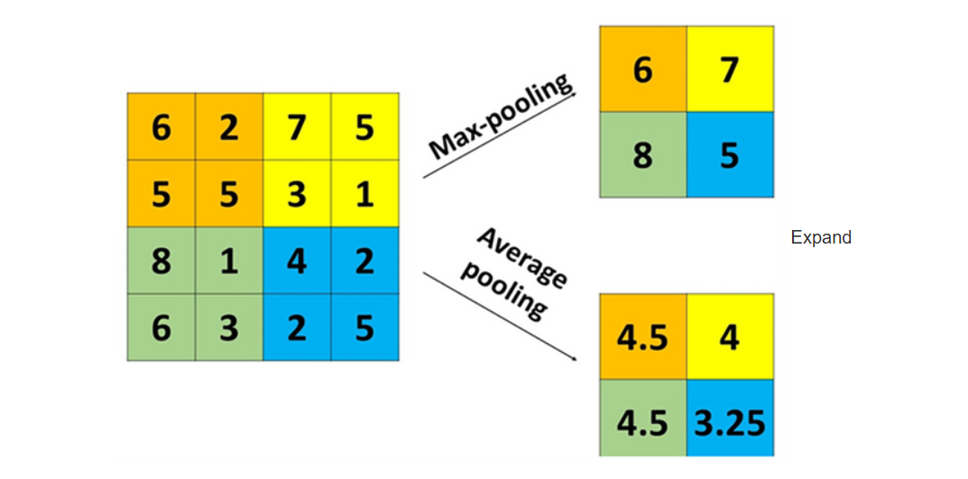
Pooling Operation

Slide 21
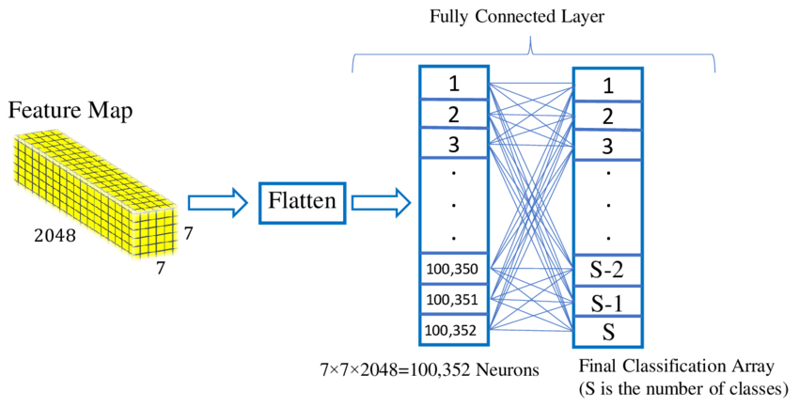
Fully Connected Layers
Where the high-level reasoning based on extracted features occurs. Transform high-dimensional feature maps into a probability distribution
After convolutional and pooling layers extract and down sample features, fully connected layers integrate these features to make predictions or classifications.
Each neuron in these layers is connected to all activations in the previous layer, allowing the network to consider the entire representation of the input data.

Slide 22
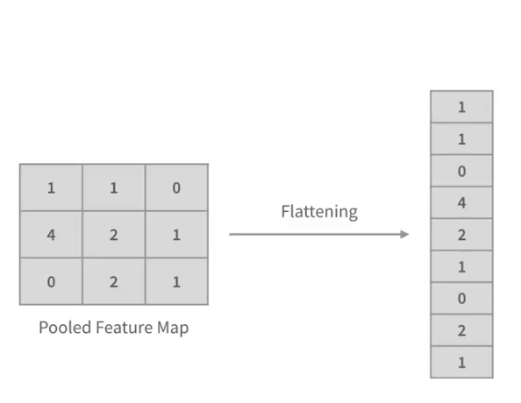
Flattening
Convolutional and pooling layers produce feature maps
Feature maps are multi-dimensional arrays
Flattening converts feature maps to one-dimensional vector
Concatenates elements along depth dimension
Enables feeding into fully connected layers

Slide 23
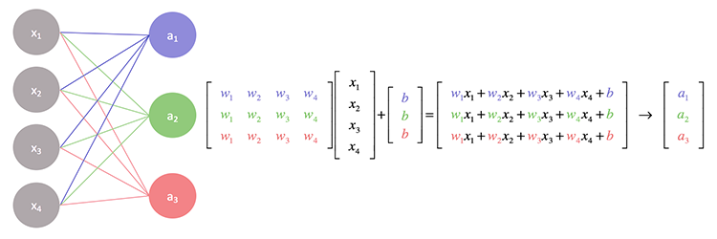
Weight Matrix and Bias Vector
Foundation for deep learning algorithms.
Fully connected layer have weight matrix (W) and bias vecor (b)
Weight matrix: (n x m), n = neurons, m = flattened vector length
Bias vector length: number of neurons in the current layer
Learnable parameters of the fully connected layer
Enable transformation and introduce nonlinearity
Input vector is multiplied by weight matrix and bias vector is added
Operation: W * input + b
Output represents weighted sum of input from previous layer

Slide 24
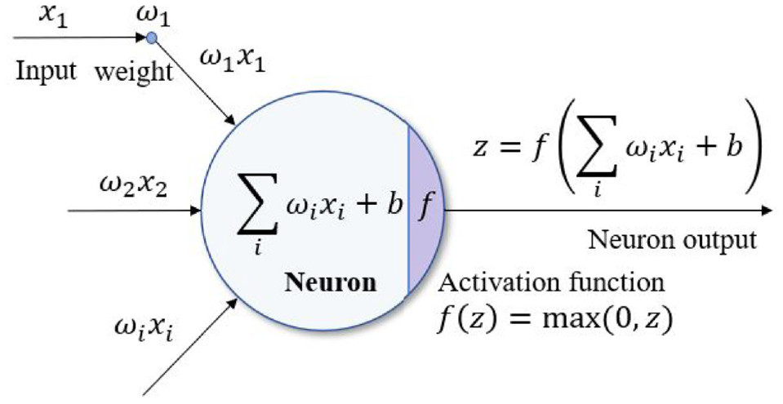
Activation Functions
Activation function determines if a neuron fires
Introduces nonlinearity to the network
Applied after convolution layer, after each fully conncted later and output layer allowing the network to learn and represent complex patterns in the data\
Most commonly used actiavtion function is ReLU

Slide 25
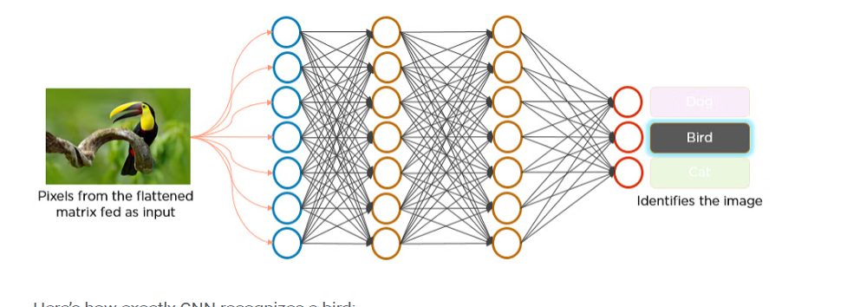
Output Layer
The final layer generates predictions
Neurons in the last layer match number of classes
Activation function differs in final layer
Softmax commonly used for multi-class classification
Highest probability neuron represents prediction

Slide 26
Back Propagation
A supervised learning algorithm used for training neural networks.
It happens only during training
Optimizes the parameters (weights and biases) of a neural network by minimizing the error between the predicted output and the actual target value.
Basic Steps are;
Feed a sample to the network
Calculate the mean squared error
Calculate the error term of each output neuron
Iteratively calculate the error terms In the hidden layers
Apply the delta rule
Adjust the weights
Notes:
(log loss)

Slide 27

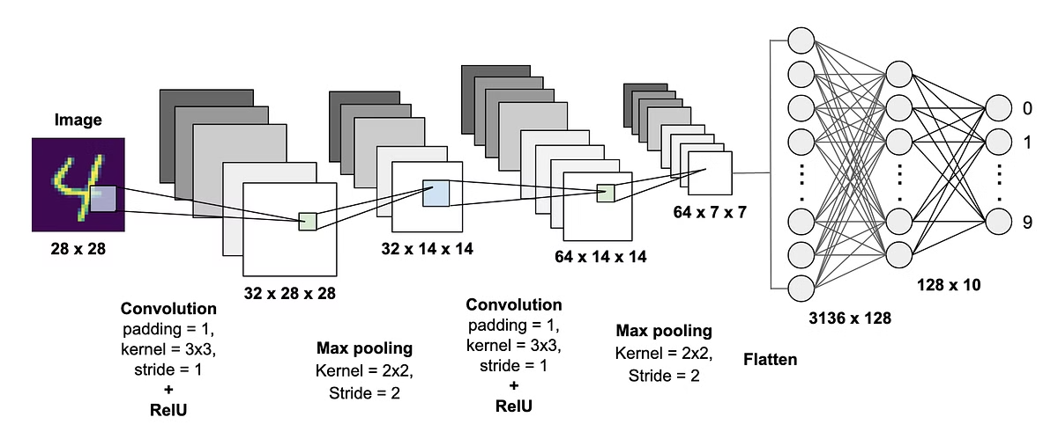
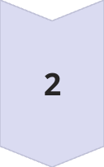
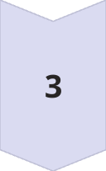
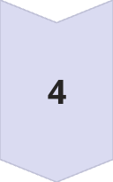
Image Processing in CNNs
Input
Raw image data enters the network.
Feature Extraction
Convolutional layers detect edges, shapes, textures.
Down-sampling
Pooling layers reduce data complexity.
Classification
Feature Extraction
Classification
Fully connected layers determine image content.

Slide 28
Applications of CNNs
CNNs have revolutionized the field of computer vision. Applications include image and video recognition, image segmentation, object detection, face recognition, and automated medical diagnosis. They are also used in self-driving cars for detecting objects and pedestrians.
Can be used for tasks like:
Image classification
Object detection
Semantic and instance segmentation
Multiple object tracking
Re-identification
Any vision task

Slide 29

Real-World CNN Impact
Medical Imaging
Anomaly detection in scans
Autonomous Vehicles
Real-time environment perception
Facial Recognition
Security and user authentication
Quality Control
Defect detection in manufacturing

Slide 30
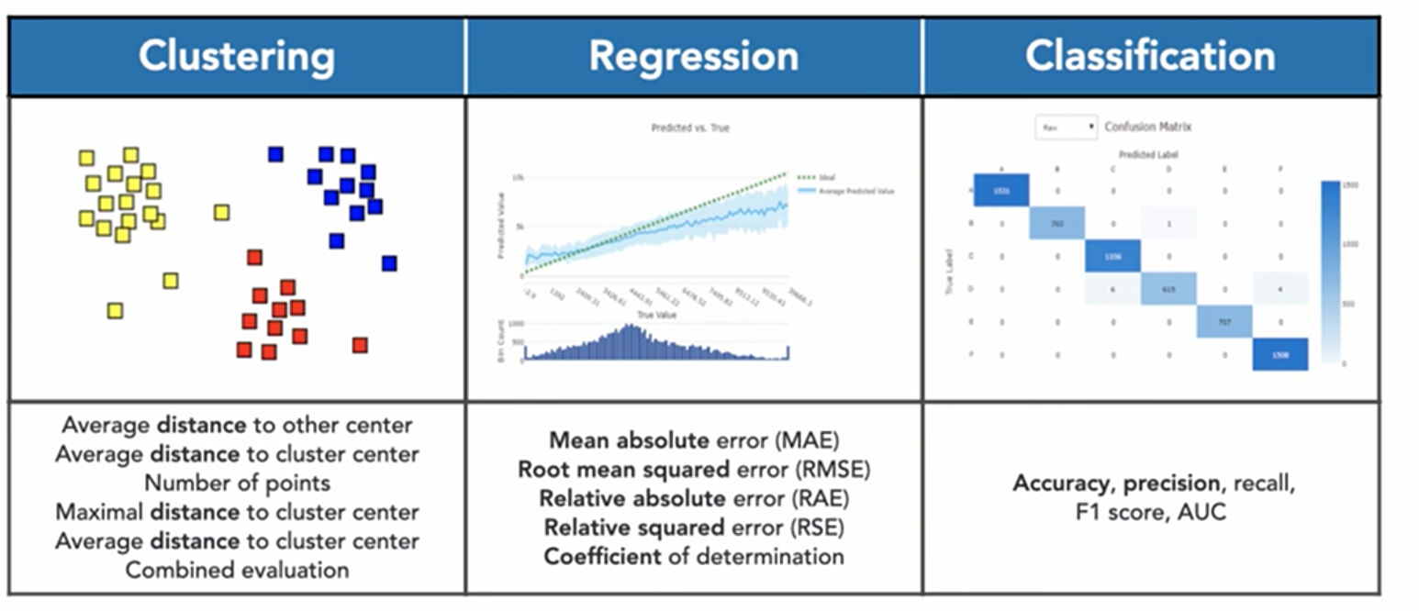
Performance Evaluation Metrics
Classification, Regression or Clustering?
https://learn.microsoft.com/en-us/azure/machine-learning/component-reference/evaluate-model?view=azureml-api-2

Slide 31
Performance Evaluation Metrics
Accuracy measures the proportion of total predictions (both positive and negative) that the model got correct, offering a general sense of its performance across all classes.
Precision assesses the accuracy of the positive predictions made by a CNN, specifically calculating the proportion of true positive predictions out of all positive predictions made (true and false positives), which is crucial in scenarios where false positives have significant consequences.

Slide 32
Performance Evaluation Metrics
Recall (or sensitivity) evaluates a CNN's ability to correctly identify all actual positive cases, measuring the proportion of true positives out of the sum of true positives and false negatives, and is important in contexts where missing positive cases is costly.
F1 score provides a balance between precision and recall by calculating their harmonic mean, offering a single metric for situations where it's crucial to maintain a balance between minimizing false positives and false negatives.
Receiver Operating Characteristic (ROC) curve plots the true positive rate against the false positive rate at various threshold settings, and the Area Under the Curve (AUC) provides a single value summarizing the overall performance of a CNN across all possible classification thresholds.

Slide 33
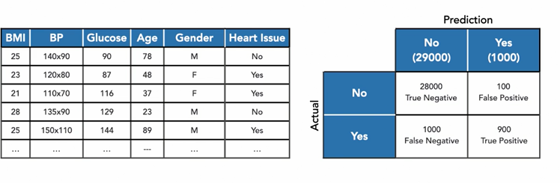
Confusion Matrix
A confusion matrix is a tool used in machine learning and statistical classification to evaluate the performance of a classification model. It provides a summary of the prediction results on a classification problem. The matrix itself is a table that compares the actual target values with the predicted values.
True Positives (TP): The number of correct positive predictions.
True Negatives (TN): The number of correct negative predictions.
False Positives (FP): The number of incorrect positive predictions.
False Negatives (FN): The number of incorrect negative predictions.

Slide 34
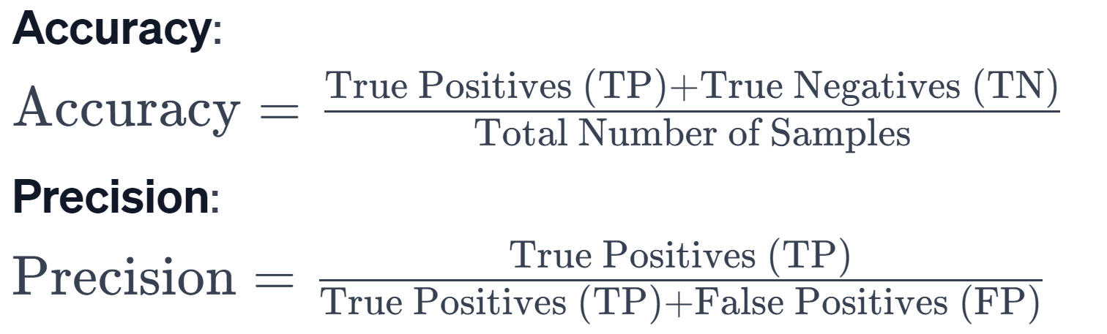
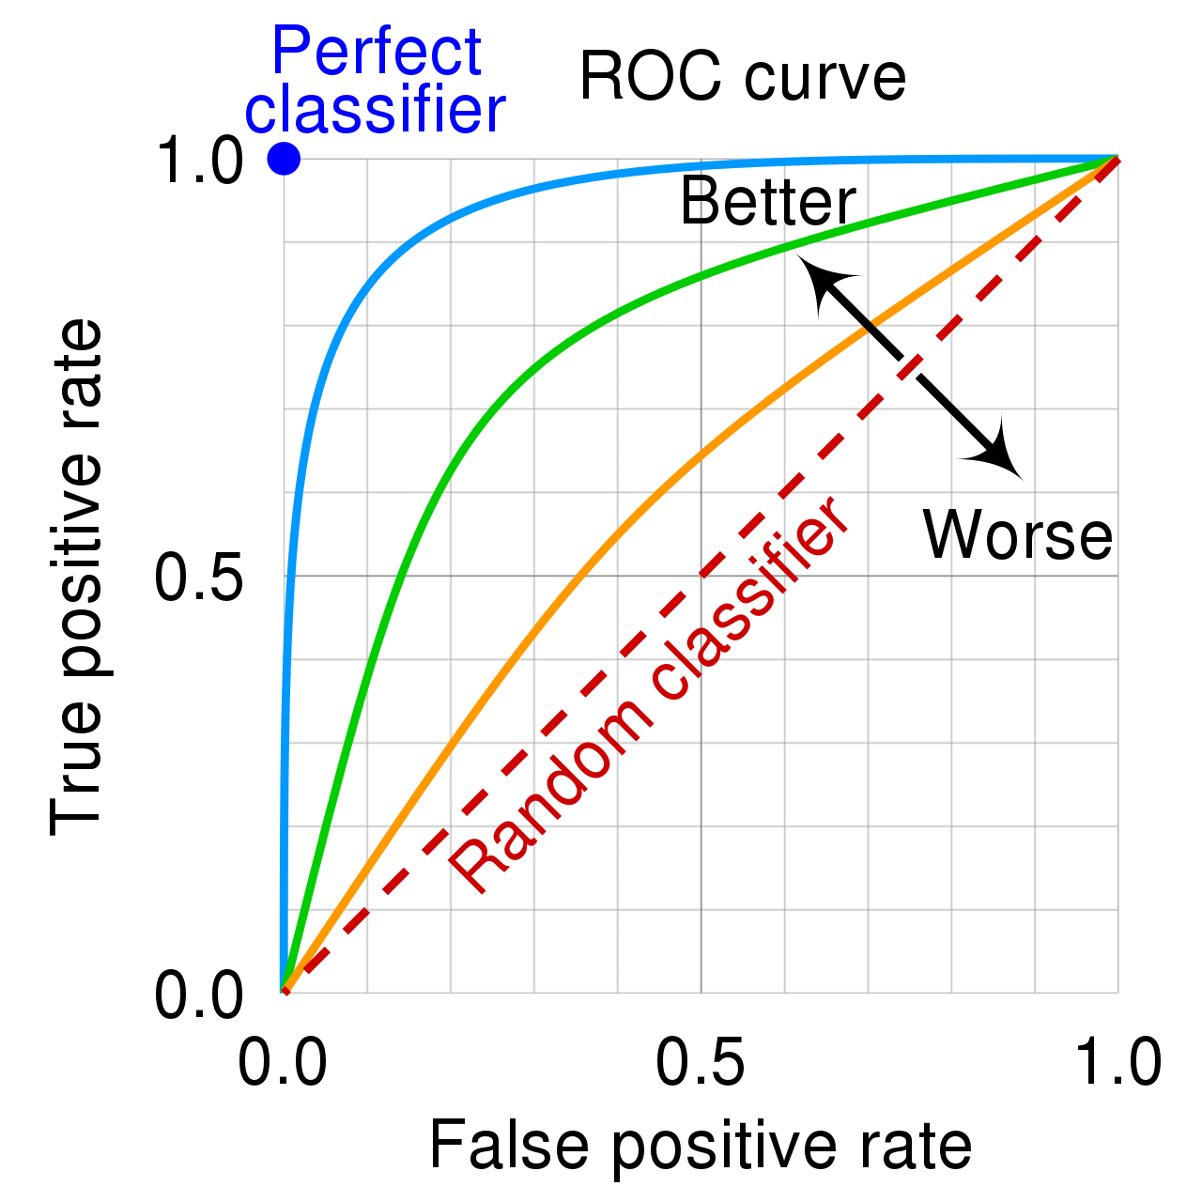
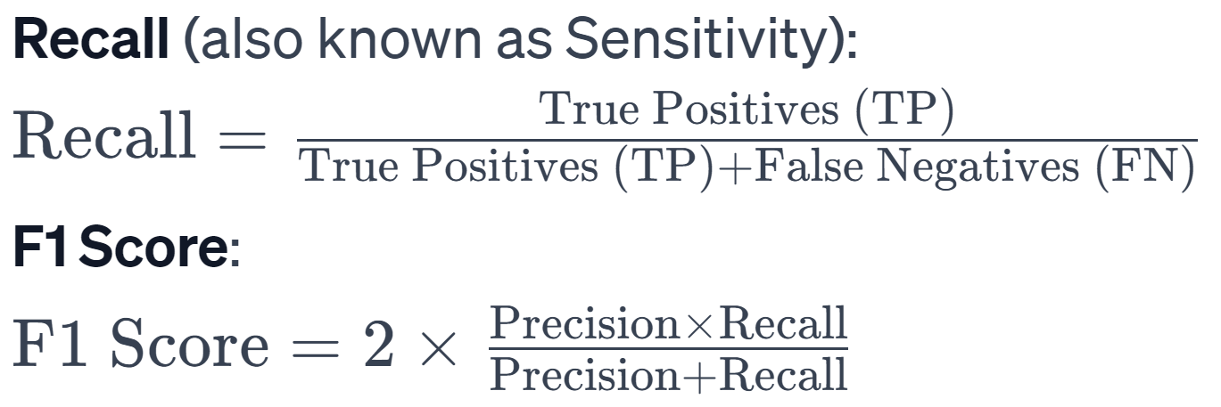
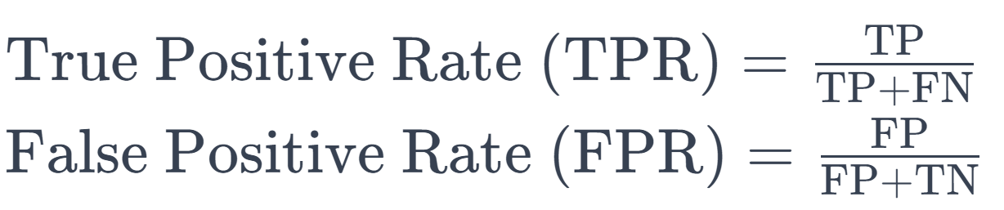
Performance Evaluation Metrics

Slide 35
Ethical Considerations and Bias in CNNs
Privacy: Privacy concerns arise when CNN models process sensitive personal data, such as facial images or medical records, potentially leading to unauthorized access or misuse of personal information if data security is not adequately maintained. This also causes issues when collecting and annotating data.
Surveillance: The use of CNNs in surveillance systems can enhance public safety and security by identifying threats more efficiently; however, it also raises ethical issues related to mass surveillance and the potential infringement on individuals' rights to privacy and freedom.
Bias in AI: particularly in CNNs, occurs when the data used to train these models contain inherent prejudices, leading to skewed or unfair outcomes in decision-making processes, often reinforcing existing societal stereotypes and discriminations.

Slide 36

References
https://austingwalters.com/edge-detection-in-computer-vision
https://www.kaggle.com/datasets/tongpython/cat-and-dog
Google search
https://gamma.app/#images
https://www.semanticscholar.org/paper/Cats-and-dogs-Parkhi-Vedaldi/84b50ebe85f7a1721800125e7882fce8c45b5c5a
https://www.simplilearn.com/tutorials/deep-learning-tutorial/convolutional-neural-network
https://www.analyticsvidhya.com/blog/2021/08/beginners-guide-to-convolutional-neural-network-with-implementation-in-python/
https://learn.microsoft.com/en-us/azure/machine-learning/component-reference/evaluate-model?view=azureml-api-2
.

Slide 37

Next Week Topics
CNN Training Process
Loss Function
Different types of Activation Functions
Back propagation Algorithm
Common Problems in Machine Vision
CNN Solutions
.

